Slide 1
Regular Expressions
Mohammad Hasan
CSE, CUET

Slide 2
Introduction
Regular expressions are an algebraic way to describe languages.
They describe exactly the regular languages.
If E is a regular expression, then L(E) is the language it defines.
Application: text-search, compiler design, Utilities (AWK, GREP in UNIX), modern programming languages (PERL), and text editors all provide mechanisms for the description of patterns using RE.

Slide 3
Introduction
(5+3) x 4 [arithmetic expression]
(0 U 1) * 1 [Regular expression]
RE offer something that automata do not:
A declarative way to express the strings we want to accept. Thus, RE serve as the input language for many systems that process strings.

Slide 4
Examples
Search commands such as the UNIX grep or equivalent commands for finding strings that one sees in Web browsers or text-formatting systems.
These systems use a RE like notation for describing patterns that the user wants to find in a file.
2. Lexical-analyzer generators, such as Lex/Flex.
A generator accepts descriptions of the forms of tokens, which are essentially REs, and produces a DFA that recognizes which token appears next on the input

Slide 5
RE: Definition
R is a regular expression if R is
1. a for some a in the alphabet Σ
2. ∈
3. ∅
4. (R₁ U R₂), where R₁ & R₂ are RE
5. (R₁ o R₂), where R₁ & R₂ are RE
6. (R₁*), where R₁ is RE

Slide 6
RE: Definition
Basis 1: If a is any symbol, then a is a RE, and L(a) = {a}.
Note: {a} is the language containing one string, and that string is of length 1.
Basis 2: ε is a RE, and L(ε) = {ε}.
Basis 3: ∅ is a RE, and L(∅) = ∅.

Slide 7
RE: Definition
Induction 1: If E₁ and E₂ are REs, then E₁+E₂ is a RE, and L(E₁+E₂) = L(E₁)∪L(E₂).
Induction 2: If E₁ and E₂ are REs, then E₁E₂ is a RE, and L(E₁E₂) = L(E₁)L(E₂).
Concatenation : the set of strings wx such that w
is in L(E₁) and x is in L(E₂).

Slide 8
RE: Definition
Induction 3: If E is a RE, then E* is a RE, and L(E*) = (L(E))*.
Closure, or “Kleene closure” = set of strings
w₁w₂…w_{n}, for some n > 0, where each w_{i} is
in L(E).
Note: when n=0, the string is ε.

Slide 9
Precedence of Operators
Parentheses may be used wherever needed to influence the grouping of operators.
Order of precedence is * (highest), then concatenation, then + (lowest).

Slide 10
Examples: RE’s
L(01) = {01}.
L(01+0) = {01, 0}.
L(0(1+0)) = {01, 00}.
Note order of precedence of operators.
L(0*) = {ε, 0, 00, 000,… }.
L((0+10)*(ε+1)) = all strings of 0’s and 1’s without two consecutive 1’s.

Slide 11
Example: Σ = {0, 1}
0*10* = {w|w has exactly a single 1}
Σ*1 Σ* = {w|w has at least one 1}
Σ*001 Σ* = {w|w contains the strings 001 as a substring}
(Σ Σ)* = {w|w is a string of even length}
-the length of a string is the number of symbols that it contains
5. (Σ Σ Σ)* = {w| the length of w is a multiple of three}
6. 01 U 10 = {01, 10}
7. 0 Σ* 0 U 1 Σ* 1 U 0 U 1 = {w|w starts & ends with the same symbol}
8. (0 U ∈) 1* = 01* U 1* the expression 0 U ∈ describes the language {0, ∈}, so the concatenation operation adds either 0 or ∈ before every string in 1*

Slide 12
Example: Σ = {0, 1}
9. (0U ∈) (1 U ∈) = {∈, 0, 1, 01}
10. 1 * ∅ = ∅ Concatenating the empty set to any set yields the empty set
11. ∅* = {∈}
The Star operation puts together any number of strings from the language to get a string in the result. If the language is empty, the star operation can put together 0 strings, giving only the empty string.

Slide 13
Example: Σ = {0, 1}
R U ∅ = R: adding the empty language to any other language will not change it
R o ∈ = R: adding the empty string to any string will not change it
R U ∈ ≠ R
If R = 0, then L(R) = {0} but L (RU ∈) = {0, ∈}
R o ∅ ≠ R
If R = 0, the L (R) = {0} but L (R o∅) = ∅

Slide 14
Importance
REs are useful tools in the design of compilers for programming languages.
Elemental objects in a programming language, called tokens, such as the variable names and constants, may be described with RE.
A numerical constant that may include a fractional part and/or a sign may be described as a member of the language
{+, -, ∈} {D D* . U D D* . D* U D* . D D*}
Where, D = {0, 1, 2, 3, 4, 5, 6, 7, 8, 9}
Expressions: 72, 3.14159, + 7. , and -.01
Once the syntax of the tokens have been described with the REs, automatic systems can generate the lexical analyzer, the part of a compiler that initially processes the input program.

Slide 15
Theorem 1: The class of regular languages is closed under the union operation
Proof Idea:
Regular languages A₁ and A₂
Prove that A₁ U A₂ is regular
Take two NFAs N₁ & N₂ for A₁ & A₂ and combined them into one new NFA, N
Machine N must accept its input if either N₁ or N₂ accepts this input
The new machine has a new state that branches to the start states of the old machines with ∈arrows

Slide 16
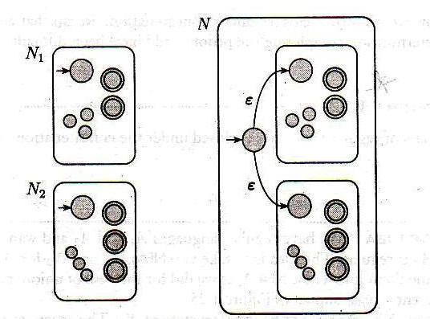
Construction of NFA N to recognize A₁ U A₂

Slide 17
Proof
Let N₁ = (Q₁, Σ, δ₁, q₁, F₁) recognize A₁,
N₂ = (Q₂, Σ, δ₂, q₂, F₂) recognize A₂,
Construct N = (Q, Σ, δ, q₀, F) recognize A₁U A₂
Q = {q₀} U Q₁ U Q₂
The states of N are all the states of N₁ & N₂, with the addition of a new start state q₀.
2. The state q₀ is the start state of N.

Slide 18
Proof
3. The accept states F = F₁ U F₂.
The accept states of N are all the accept states of N₁ & N₂. That way N accepts if either N₁ accepts or N₂ accepts.
4. Define δ so that for any q∈Q & any a∈Σ_{ε}

Slide 19
Theorem 2: The class of regular languages is closed under the concatenation operation
Proof Idea:
Regular languages A₁ and A₂
Prove that A₁ o A₂ is regular
Take two NFAs, N₁ & N₂ for A₁ & A₂ and combined them into a new NFA, N
Assign N’s start state to be the state of N₁
The accept states of N₁ have additional ε arrows that allow branching to N₂ whenever N₁ is in an accept state, signifying that it has found an initial piece of the input that constitutes a string in A₁.

Slide 20
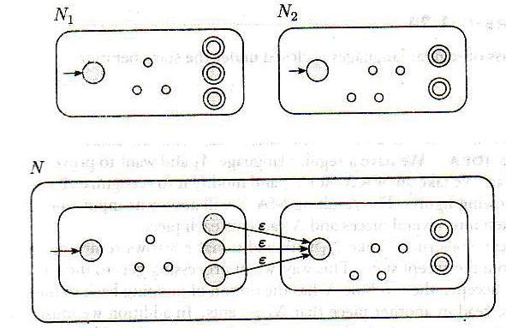
The accept states of N are the accept states of N₂ only.
Therefore, it accepts when the input can be split into two parts, the first accepted by N₁ and the second by N₂.

Slide 21
Proof
Let N₁ = (Q₁, Σ, δ₁, q₁, F₁) recognize A₁,
N₂ = (Q₂, Σ, δ₂, q₂, F₂) recognize A₂,
Construct N = (Q, Σ, δ, q₁, F₂) recognize A₁o A₂
Q = Q₁ U Q₂
The states of N are all the states of N₁ & N₂,
2. The state q₁ is the same as the start state of N₁.

Slide 22
3. The accept states F₂ are the same as the accept state of N₂.
4. Define δ so that for any q∈Q & any a∈Σ_{ε}

Slide 23
Theorem 3: The class of regular languages is closed under the star operation
Proof Idea:
Regular languages A₁
Prove that A₁* also is regular
Take an NFA, N for A₁ and modify it to recognize A₁*
Resulting NFA N will accept its input whenever it can be broken into several pieces & N₁ accepts each piece.

Slide 24
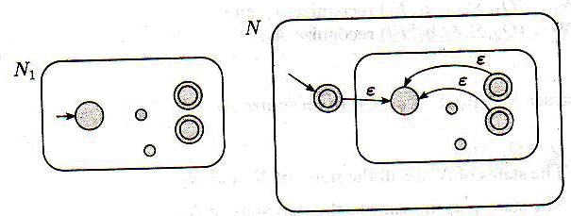
Proof:
Let N₁ = (Q₁, Σ, δ₁, q₁, F₁) recognize A₁,
Construct N = (Q, Σ, δ, q₀, F) recognize A₁*
Q = {q₀} U Q₁
The states of N are the states of N₁ + a new state
2. The state q₀ is the new start state

Slide 25
3. F = {q₀} U F₁.
The accept states are the old accept states + the new start state
4. Define δ so that for any q∈Q & any a∈Σ_{ε}

Slide 26
Equivalent with Finite Automata
RE and FA are equivalent in their descriptive power.
This fact is rather remarkable, because FA & RE superficially appear to be rather different.
However, any RE can be converted into a FA that recognizes the language it describes, & vice-versa.
Recall that a Regular language is one that is recognize by some FA

Slide 27
Theorem: A language is regular if and only if some regular expression describe it
Two directions: 02 lemmas
Lemma 1: if a language is described by a RE, then it is regular
Proof Idea: Say that we have a RE R describing some language A.
We show how to convert R into an NFA recognizing A
If an NFA recognizes A then A is regular.

Slide 28
Proof
Let’s convert R into NFA N.
Six cases:
R = a for some a in Σ. Then L (R)={a}, and the following NFA recognizes L (R)
a

Slide 29
Note: this machine fits the definition of an NFA but not that of a DFA because it has some states with no exiting arrow for each possible input symbol.
Formally, N = ({q₁, q₂}, Σ, δ, q₁, {q₂}), where we describe δ by saying that δ (q₁, a) = {q₂},
(r, b) = ∅ for r ≠q₁ or b ≠ a
2. R = ε. Then L (R) = {ε}, and the following NFA recognizes L (R).
Formally, N = ({q₁}, Σ, δ, q₁, {q₁}), where δ (r, b) = ∅ for any r and b

Slide 30
3. R = ∅. Then the following NFA recognizes L (R)
4. R = R₁ U R₂
5. R = R₁ o R₂
6. R = R₁*.
Formally, N = ({q}, Σ, δ, q, {∅}), for any r and b

Slide 31
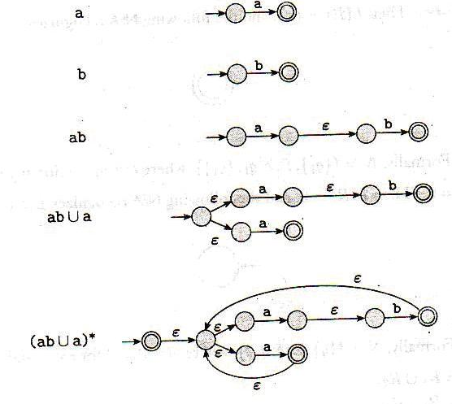
Convert RE (ab U a)* to NFA
A₂
A₁
A*

Slide 32



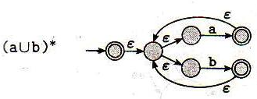

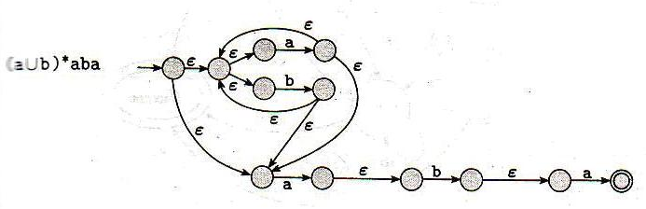
Convert (a U b)*aba to NFA

Slide 33
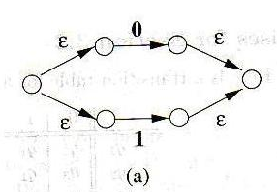
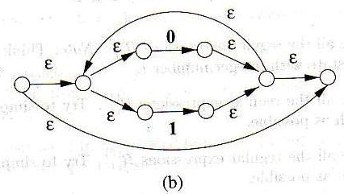
Convert (0+1)* 1 (0+1) to an ε-NFA

Slide 34
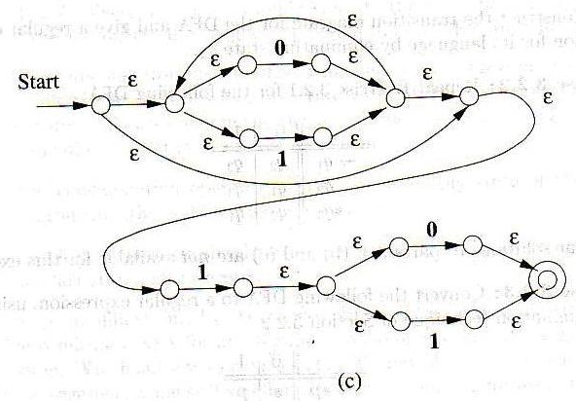

Slide 35
Assignments
Convert the Following to NFA
1. (0 U 1)* 000 (0 U 1)*
2. a* U b*
3. aba U bab
4. a (ba)* b
5. (ε U a) b

